Slide 1

Computational biology workflow systems – making analysis reproducible
Adam Cribbs

Slide 2
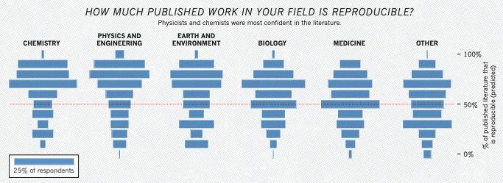
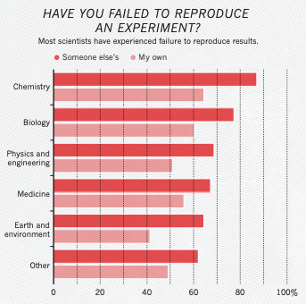
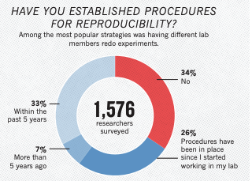
The reproducibility crisis – the same issue for data
https://www.nature.com/articles/533452a

Slide 3
Open science is not reproducible science
Open science focuses on accessibility (data, code, publications freely available).
Reproducible science focuses on repeatability of results.
Simply sharing materials does not guarantee others can regenerate findings.
Transparency is necessary — but not sufficient — for reproducibility.
Reproducibility is hard – differing environments, setup, dependancies e.c.t.

Slide 4




What open science typically provides
Publicly available datasets
Shared source code (e.g. GitHub)
Preprints and open-access publications
Registered protocols
But often missing:
Computational environment details
Exact software versions
Dependency management
Random seeds / stochastic controls
Hardware specifications (relevant in ML or HPC contexts)

Slide 5
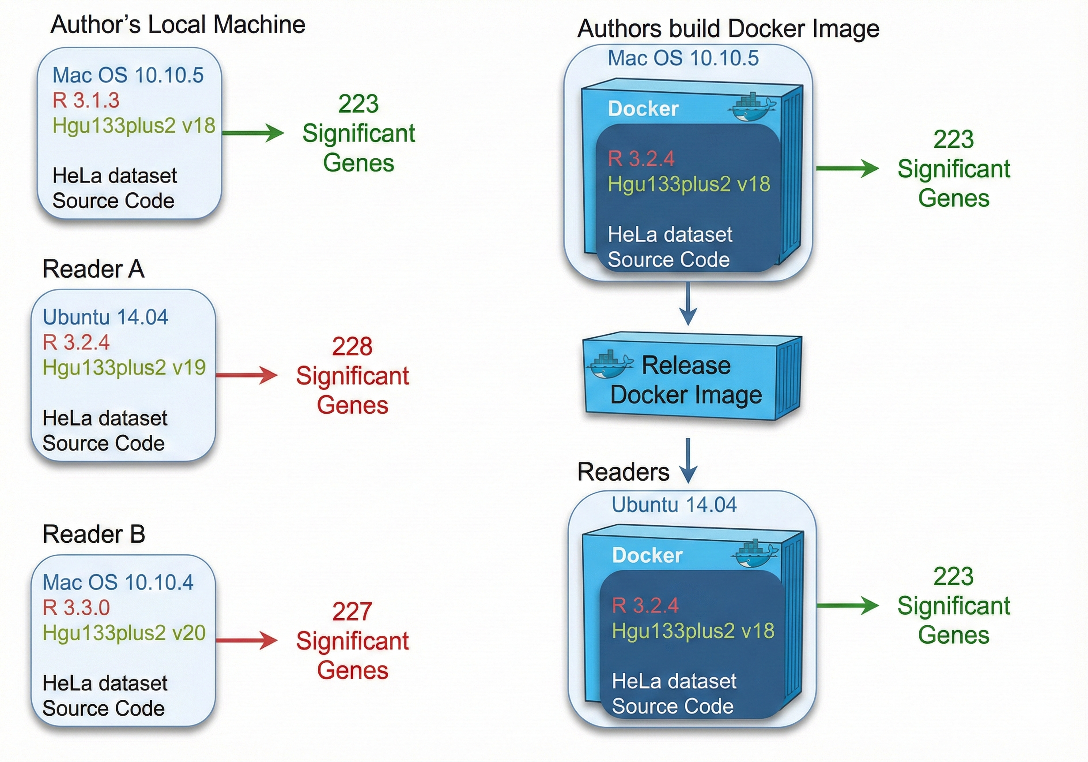
Software and dependency hell

Slide 6
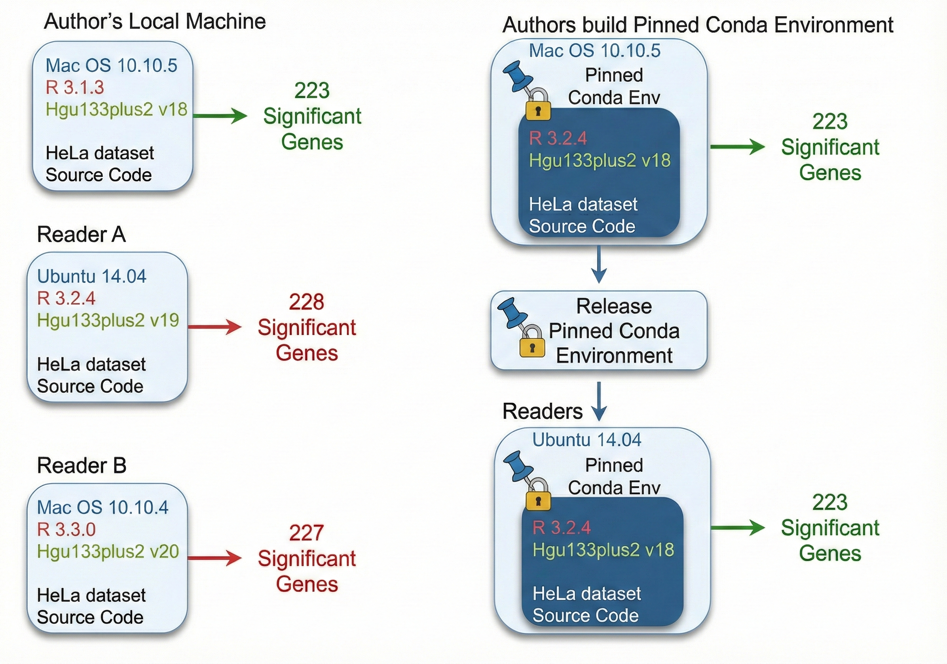
Software and dependency hell

Slide 7
Workflow managers
A bioinformatics workflow is a structured series of computational steps designed to process, analyse and interpret data generated from experiments such as next-generation sequencing (NGS).
We orchestrate this using workflow managers

Slide 8
Workflows
*.fastq
Input
Perform multiple processing steps in turn
Start a task only when all upstream dependencies are completed
Perform steps in parallel for multiple input files
Mapping
Task
*.bam
Output
Input
flagstat
Task
*.flagstat
Output

Slide 9
Why use a workflow manager
Each job/task can be run within its own environment/container
Failures handled elegantly, then re-started
Portable – can send it to community and it should work
Scalable – either 1 sample of 500 samples – on a laptop or on a HPC
Efficient – parallelisable jobs

Slide 10
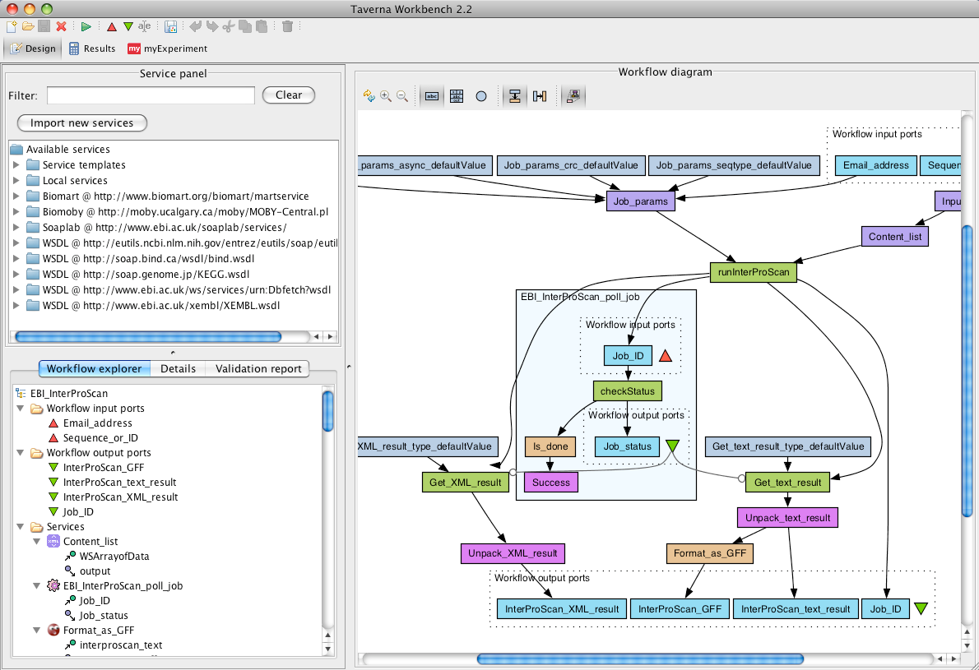
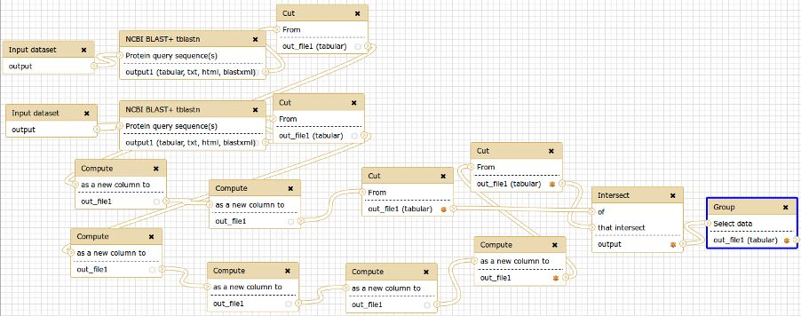
Bioinformatic workbenches
Taverna
Advantages
No programming required
Disadvantages
Black-box
Limited to available tools
Limited complexity
Require expert administration
Commercial systems:
Genomatix, CLCBio, Partek,

Slide 11
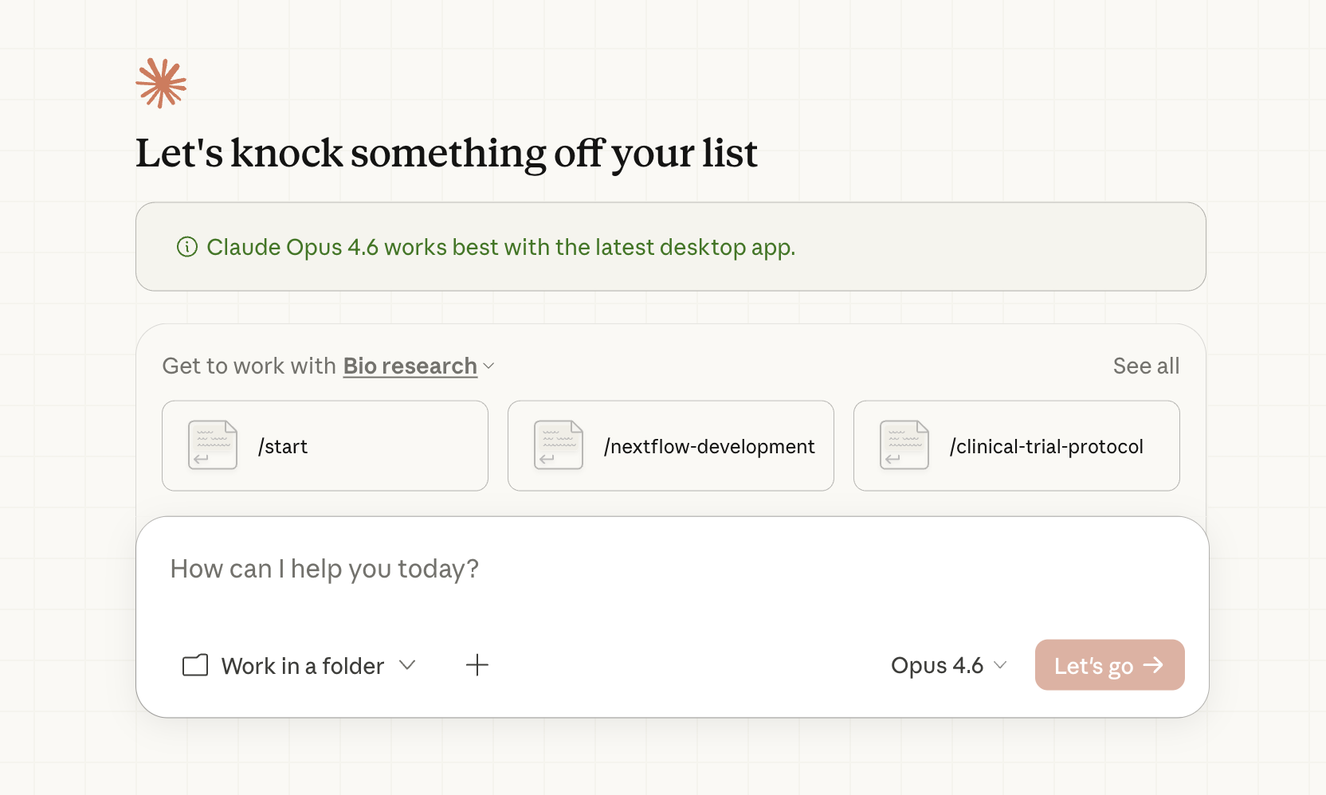
LLM approach – Claude cowork
Advantages
Write in natural language to get an output
No comp bio knowledge required
Disadvantages
Not reproducible
Limited tool availability
No comp bio knowledge required

Slide 12
Workflow managers
Ruffus/Cgat-core
Snakemake
Nextflow
Cromwell
Galaxy
Choosing which one is a trade off between learning curve, ease of use and richness in the functionality each provide

Slide 13

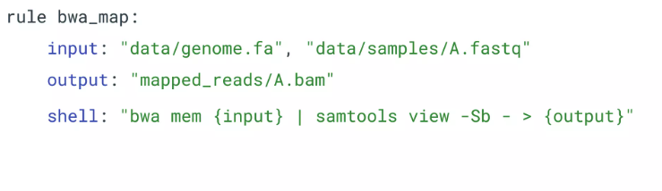
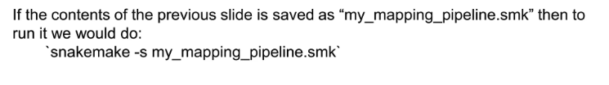
Snakemake
Based on Python & Make
Split your workflow into separate “rules”
One rule per process
Rules have:
A rule name
Input files
Output files
A command to turn the input to the output

Slide 14

Nextflow
Based on Groovy (JVM) + dataflow programming
Split your workflow into separate processes
One process per computational step
Processes are connected via channels (data streams)
A process has:
A process name
Declared input(s) (via input: block)
Declared output(s) (via output: block)
A script/command section to transform input into output

Slide 15

Cgat-core/ruffus
Based on Python decorators + Ruffus workflow library
Split your workflow into separate Python functions
One function per processing step
Dependencies defined via decorators
A task has:
A Python function name
Decorator(s) defining input and output files (e.g. @transform, @merge, @split)
Explicit input and output arguments
Python code or shell commands to transform input into output

Slide 16

Ruffus
Open-source workflow library for Python
Lightweight: Suitable for the simplest of tasks
Scalable: Handles even fiendishly complicated pipelines
Standard python: Uses decorators to wrap standard functions
Features
Flow control from one function to the next
Allows tasks to be completed sequentially
If the pipeline fails, ruffus will restart where it left off
https://ruffus.readthedocs.io/en/latest/

Slide 17
CGAT-core
Computational Genomics Analysis Toolkit
Based on Python decorators + Ruffus workflow library
Split your workflow into separate Python functions
One function per processing step
Dependencies defined via decorators
A task has:
A Python function name
Decorator(s) defining input and output files (e.g. @transform, @merge, @split)
Explicit input and output arguments
Python code or shell commands to transform input into output

Slide 18
Building and running a CGAT-core pipeline
Write pipeline script
Series of Python functions (tasks)
Import Ruffus to manage task dependencies (decorators)
Import CGATcore to manage parametrisation, logging, cluster interaction and pipeline running
Write configuration files
Define all pipeline parameters in pipeline.yml
Run from the command line
Examine output
Log files
Output files
Database tables
Reports with plots (Rmarkdown, Notebooks)

Slide 19
Ruffus tasks
Input
Task
Output
Filename1
Filename2
….
Python function
Filename1
Filename2
….

Slide 20
Common opperations
Filename1
Filename2
Filename3
…
Transform
Filename1
Filename2
Filename3
…
One-to-one
Filename1
Filename2
Filename3
…
Merge
Filename1
All-to-one
Filename1
Filename2
Collate
Filename1
Many-to-one

Slide 21
Example pipeline
FASTQ file1
FASTQ file2
FASTQ file3
FASTQ file4
Transform
FastQC report
FastQC report
FastQC report
FastQC report
Merge
MultiQC report

Slide 22
Example pipeline
FASTQ file1
FASTQ file2
FASTQ file3
FASTQ file4
Collate
SAM file1
SAM file2

Slide 23
Defining tasks and functions
Transform
def fastqc(infile, outfile):
statement = ’’’fastqc %(infile)s
> %(outfile)s.log’’’
P.run(statement)
Any command
line statement
Run command line statement
Merge
def multiqc(infiles, outfile):
statement = ’’’multiqc .
> %(outfile)s.log’’’
P.run(statement)
Collate
def mapping(infiles, outfile):
infile1, infile2 = infiles
statement = ’’’hisat2…’’’
P.run(statement)

Slide 24
Python decorators
Decorators dynamically alter the functionality of a function
Enables you to run a function before another function call
@transform
Checks dependencies are satisfied
configures input & output files
passes them to inner function

Slide 25
Defining task Input and Outputs
Transform
@transform( [ ‘a_1.fq.gz’, ‘a_2.fq.gz’],
suffix(‘.fq.gz’),
‘_fastqc.html’)
def fastqc(infile, outfile):
List of input files
File suffix to replace
Output file suffix
Merge
@merge([‘a_1_fastqc.html’,’a_2_fastqc.html’],
‘multiqc_report.html’)
def multiqc(infiles, outfile):
List of input files
Output file
Collate
@collate("*.fastq.gz",
regex(r'(.*)_[12].fq.gz’),
r'bam/\1.bam')
def mapping(infiles, outfile):
Glob of input files
Regular expression
Output file regex

Slide 26
Combining tasks
Transform
@transform( [ ‘a_1.fq.gz’, ‘a_2.fq.gz’],
suffix(‘.fastq.gz’),
‘_fastqc.html’)
def fastqc(infile, outfile):
List of input files
File suffix to replace
Output file suffix
Merge
@merge([‘a_1_fastqc,html’,’a_2_fastqc.html’],
‘multiqc_report.html’)
def multiqc(infiles, outfile):
List of input files
Output file

Slide 27
Combining tasks
Transform
@transform( [ ‘a_1.fq.gz’, ‘a_2.fq.gz’],
suffix(‘.fastq.gz’),
‘_fastqc.html’)
def fastqc(infile, outfile):
List of input files
File suffix to replace
Output file suffix
Merge
@merge(fastqc,
‘multiqc_report.html’)
def multiqc(infiles, outfile):
List of input files
Output file

Slide 28
General pipeline structure
Documentation
‘’’Description of pipeline and dependencies’’’
Docstring
from ruffus import *
from cgatcore import pipeline as P
import sys
Import section
Import statements
Read Parameters
PARAMS = P.get_parameters(“pipeline.yml”)
Load options from config file
Parameters added to PARAMS dictionary
Define Tasks
@transform(‘*.fq.gz’, suffix(‘.fq.gz’), ‘_fastqc.html’)
def fastqc(infile, outfile):
Write processing functions
and combine
__main__
if __name__ == “__main__”:
sys.exit( P.main(sys.argv) )
If script run from command line
Run main function from CGATcore pipeline.py

Slide 29
Parameter definition
pipeline.yml
Usually located in pipeline working directory
section:
key: value
File organised into sections
Add parameters as key-value pairs
indentation
genome: hg19
bowtie:
index_dir: /databank/bowtie
PARAMS =
{
‘genome’ : ‘hg19’,
‘bowtie_index_dir’: ‘/databank/bowtie’
}
Parameters added to PARAMS dictionary
section name prefixed to key

Slide 30
Inside a task
Specify input files
Regular expression
glob
Insert regex group here
@transform( ‘*.fastq.gz’, regex(r‘(.*).fastq.gz’), r’trim/\1_fastq.gz’)
Raw string literal
(no escape characters)
Match any character
0 or more time
Extract as group
def trim_reads(infile, outfile):
statement = ‘‘‘
zcat %(infile)s
| fastx_trimmer %(trim_options)s
2> %(outfile)s.log
| gzip > %(outfile)s’’’
P.run(statement, job_queue = ‘all.q‘,
job_threads = 8, job_memory = ’8G’
job_condaenv = ‘obds_py3’)
Variable
interpolation
Parameter
interpolation
CGATcore command

Slide 31
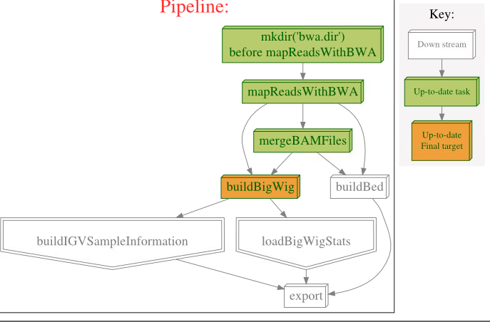
Running from the commandline
CGATcore enables us to interact with Ruffus pipelines using actions
show – show which functions will run when you run the pipeline
plot – plot a schematic showing the status of the pipeline functions
make – run the pipeline
$ python mapping.py plot buildBigWig
Pipeline script
Action
Target function name

Slide 32
Running from the commandline
To run a task append the name of the function you want to run to the “make” action
Ruffus will run everything up to and including this function if:
output is not already present
Timestamp of input file is more recent than timestamp of output file
$ python pipeline_test.py make multiqc
Command line options:
v verbosity level (recommend 5)
Controls level of logging messages printed to screen / log file
$ python pipeline_test.py make multiqc –v 5

Slide 33
Additional decorators
@follows
Ensure a task follows another non-dependent task
@split
Split input file into multiple output files (one to many)
@active_if
Include optional tasks
@permutations
Generate all possible permutations of input files
https://ruffus.readthedocs.io/en/latest/tutorials/new_tutorial/decorators_compendium.html

Slide 34
Grouping tasks
Pipelines can have many independent branches
It is often helpful to add merge functions or dummy functions
after each section of the pipeline
At the end to run the whole pipeline
@merge(flagstat, idxstat,
picard_isize_metrics)
def mapping_qc():
statement = ‘multiqc .’
P.run(statement)
$ python mapping.py make multiqc_mapping –v 5
@follows(fastqc, mapping, mapping_qc)
def full():
pass
$ python mapping.py make full –v 5
Enables you to run multiple parallel QC tasks with a single command
Enables you to run all sections of the pipeline

